Slide 1
Medicine at Cambridge
Cambridge Open Days 2019
Dr Diana Wood (Clinical Dean), Dr Holly Canuto (Director of Education for the
Medical Sciences Tripos) and Richard Davies (Clinical Sub-Dean)

Slide 2
Three questions
Do you really want to do medicine?
Do you really want to come to Cambridge?
Why would we want you?

Slide 3
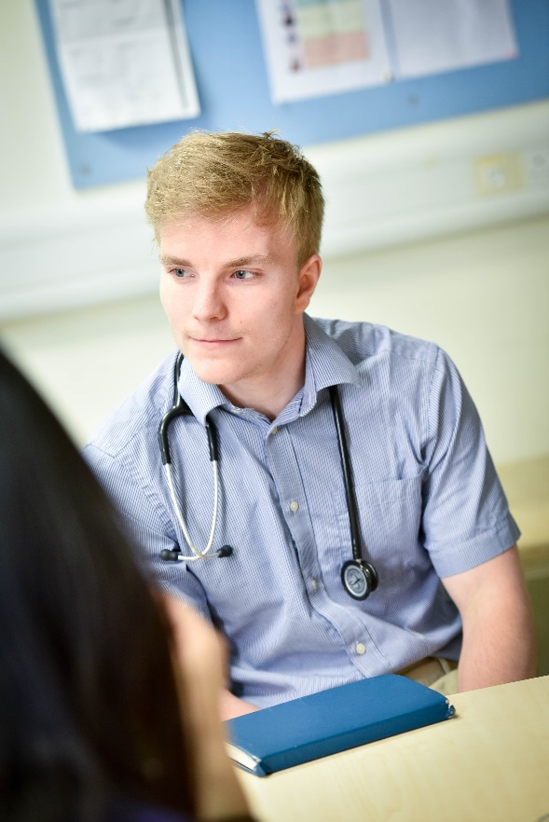
Motivation
Is it me who wants to be a doctor?
Is it ‘expected’ of me?

Slide 4
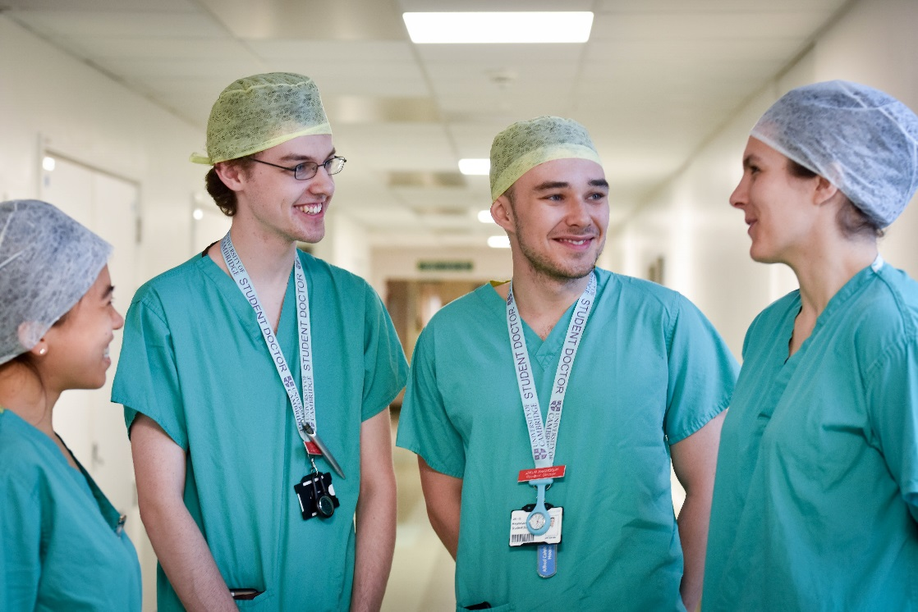
Why Medicine?
Respected
Glamorous
Meaningful
Work with people
Work in science
Challenging
Highly paid
Secure

Slide 5
Why Cambridge?
Biomedical science
Collegiate University
Personal support
Accommodation
Personal teaching
Social life
Cultural and sporting activities
An attractive place to live

Slide 6
Our aim
As a University -
To contribute to society through the pursuit of education, learning, and research at the highest international levels of excellence
As medical educators -
To produce graduates who will lead the development of modern medicine by offering:
a rigorous scientific basis for medical studies
excellence in the clinical, practical and interpersonal skills essential to high quality medical practice

Slide 7
Essential features
Education in a research-rich environment
Distinctive pre-clinical course
Whole body dissection
Strong scientific focus
Exciting clinical course
Active participation in learning throughout
Your fellow students

Slide 8
Routes into Medicine
Year | Standard-Entry (undergraduate) | Affiliate graduate entry | Cambridge Graduate Course
1 | Medical Sciences | Medical Sciences | Combined Medical Sciences & Clinical Medicine
2
 |  |  | Clinical Medicine
3 | Part II courses | Clinical Medicine
4 | Clinical Medicine
5
6

Slide 9
Medicine at Cambridge
Year of study | What you will study | Subjects and Courses | Qualifications obtained
Year 1 - IA | Scientific knowledge | Medically relevant core scientific knowledge and skills, together with some optional specialisation. | 2nd MB, Tripos IA | PRECLINICAL STUDIES
Year 2 - IB |  |  | 2nd MB, Tripos IA
Year 3 – Part II | Part II course of specialised study | A wide range of courses and subjects (other Tripos courses are also available to Medics). | BA DEGREE
Years 4, 5 and 6 | Clinical studies based at Addenbrooke’s Hospital and regional partner teaching hospitals | Clinical medicine leading to the development of clinical skills and knowledge in a range of specialties. | Final MB, leading to MB BChir | CLINICAL STUDIES

Slide 10
Year 1 (IA)
Core Science Courses:
Functional Architecture of the Body (FAB) – layout and function of the body’s structures
Molecules in Medical Science (MIMS) – chemical and molecular mechanisms underlying the functions of the body
Histology and Homeostasis (HOM) – mechanisms underlying communication/maintenance of a stable internal environment within the body
Clinical Strand Courses:
Introduction to the Scientific Basis of Medicine (ISBM) – epidemiology and application to medicine
The Social and Ethical Context of Health and Illness (SECHI) – cultural aspects of health care
Preparing for Patients (PfP A) – experience in meeting patients at GP surgeries

Slide 11
Year 2 (IB)
Core Science Courses:
Mechanisms of Drug Action (MODA) – mechanisms of drug action upon the body
Biology of Disease (BOD) –processes underlying disease and its effects on cells, tissues and organs
Human Reproduction (HR) – structure and function of the reproductive system
Neurobiology and Human Behaviour (NHB) – structure and function of the sense organs and central nervous system and their role in determining behaviour. Also the study of psychology
Head and Neck Anatomy (HNA) – overall structure of the head and neck
Clinical Strand Courses:
Preparing for Patients (PfP B) – experience in meeting patients in hospitals
Preparing for Patients (PfP C) – visiting community based health related agencies

Slide 12
Year 3 (Part II)
Year of specialist study in any one of a wide range of subjects.
For example:
Science-related subjects
Philosophy
Management studies
Preparing for Patients course (PfP D) - experience following a pregnant woman and her family at home over some time.

Slide 13
Cambridge Clinical Course
Standard Course – 3 years
MB/PhD programme
intercalate PhD into Standard Course
Nine years in total
Cambridge Graduate Course

Slide 14
Cambridge Clinical Course
Standard Course – 3 years
MB/PhD programme
intercalate PhD into Standard Course
Nine years in total
Cambridge Graduate Course

Slide 15
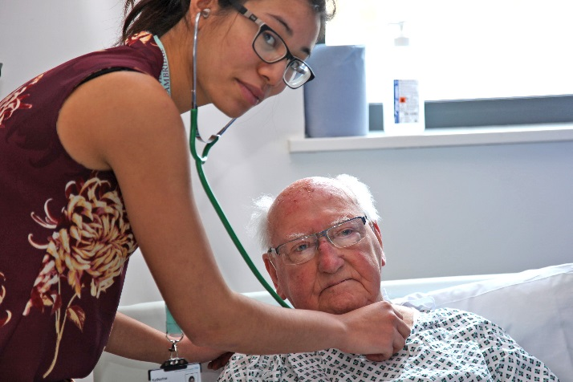
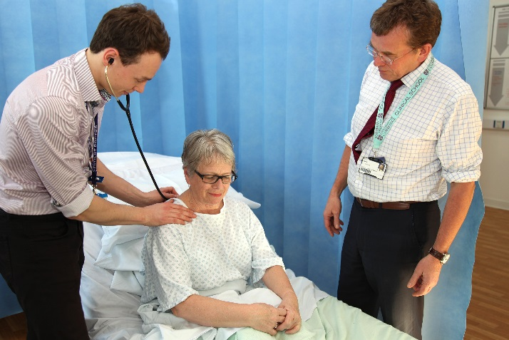
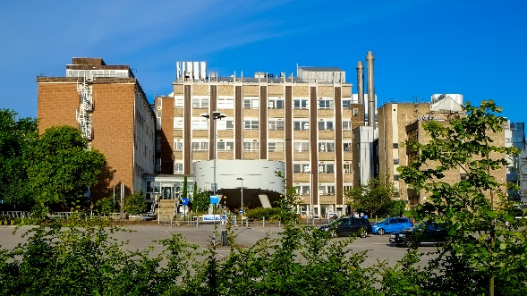
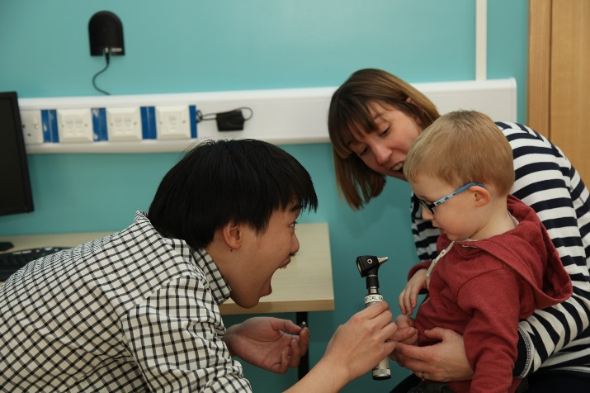
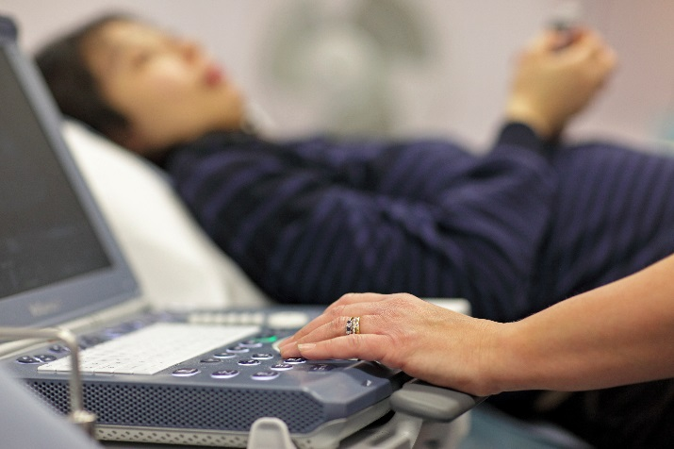
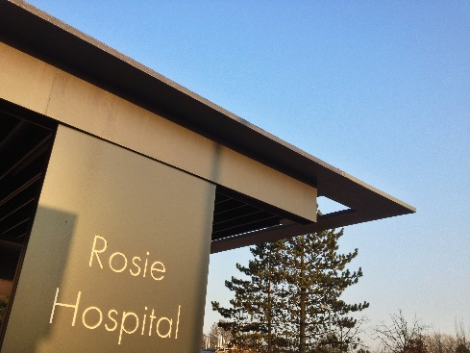
Clinical Experiences

Slide 16
Clinical teaching programme 2017-2018: schematic
YEAR 4 CCP |  | YEAR 5 SCP
 |  | R&I |  | YEAR 6 ACP
 |  |  |  | R&I
 |  |  |  | GP
INTRO COURSE
 |  | NEUROSCIENCES
CCM |  | MENTAL HEALTH
 |  | GP |  | R&I
 |  | R&I
R&I
CCM |  | MATERNAL & |  | EMERGENCY CARE
R&I |  | CHILD HEALTH
 |  |  |  | R&I / EXAM PREP
EXAMS |  | GP |  | FINAL MB PART III
VACATION
 |  | VACATION |  | VACATION
EMERGENCY CARE |  | R&I
 |  | CANCER
GP |  | TRANSPLANTATION
 |  | SPECIALIST |  | MEDICINE
 |  | SURGERY
 |  | GP
 |  | R&I |  | SURGERY AND
 |  |  |  | PERIOPERATIVE
ELECTIVE SURGERY |  | VACATION |  | CARE
VACATION
 |  |  |  | VACATION
RESEARCH / SSC |  | INFECTION &
 |  | IMMUNITY |  | EXAM PREP
 |  | CARDIOVASCULAR & |  | FINAL MB PART III
 |  | METABOLISM |  | CLINICALS
 |  | GP
GP
 |  | R&I
MEDICINE
 |  | FINAL MB PART II |  | APPRENTICESHIP
 |  |  |  | GRADUATION WEEK
 |  | VACATION
R&I
FINAL MB PART I
 |  |  |  | VACATION
VACATION
 |  | ELECTIVE |  | F1
Year 4
Core Clinical Practice
Learn the basics FINAL MB PART 1
Year 5
Specialist Clinical Practice
Explore some specialities FINAL MB PART 2
Year 6
Applied Clinical Practice
Develop clinical competence FINAL MB PART 3
Integration by Curriculum Themes
Core plus Student Selected Components (SSC’s)
Teaching at Addenbrookes, Regional Partner NHS Trusts and General Practices throughout
Graded clinical responsibility leading to clinical competence

Slide 17
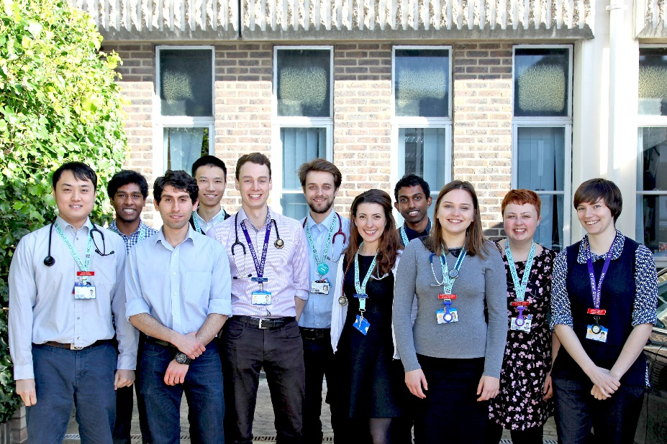
Curriculum themes
Doctor as scholar and scientist
Biomedical science
Psychological and social sciences
Population health
Scientific method
Doctor as practitioner
Clinical and communication skills
Diagnosis
Patient management
Prescribing and therapeutics
Practical procedures
Doctor as professional
Ethics and law
Reflection, learning and teaching
Multi-professional team working
Patient safety and quality management

Slide 18
Learn the basics
Year 4: Core Clinical Practice
Introductory Course – 2 weeks
Core clinical method – 2 x 4 weeks
Core Clinical Practice placements – 4 x 6 weeks
Placements in:
Medicine & General Practice
Emergency Care and General Practice
Elective Surgery and Anaesthetics
Research / SSC

Slide 19
Explore some specialities
Year 5: Specialist Clinical Practice
Placements 4 x 8 weeks (6 weeks hosp. – 2 weeks GP)
Specialist Clinical Practice placements
Maternal and Child Health
Neurosciences and Mental Health
Cancer, Transplantation and Specialist Surgery
Infection & Immunity, Cardiovascular and Metabolic Medicine
Opportunities for student choice through Student Selected Placements the Elective programme

Slide 20
Develop clinical competence
Year 6: Applied Clinical Practice
Placements 4 x 6 weeks
Applied Clinical Practice placements
Senior Medicine
Senior Emergency Care
Senior Surgery and Perioperative Medicine
Senior General Practice
6 week Apprenticeship Programme after Final MB

Slide 21
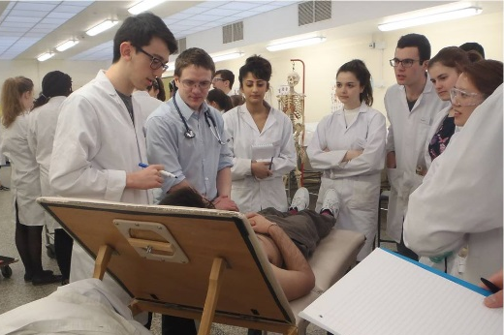
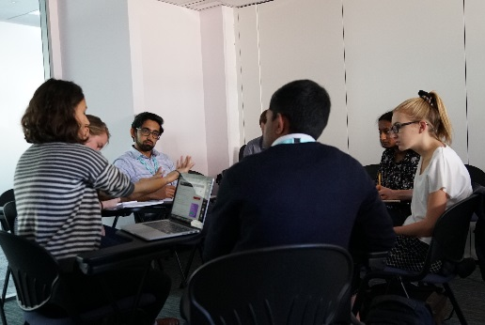
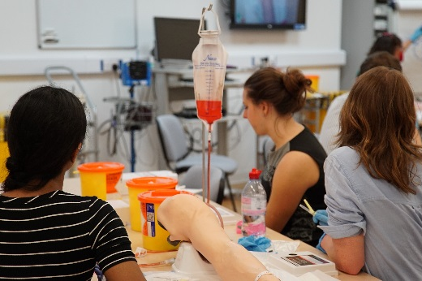
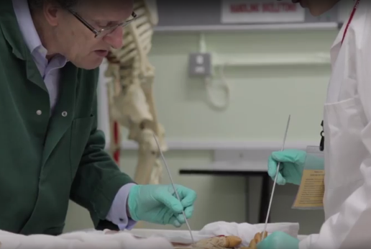
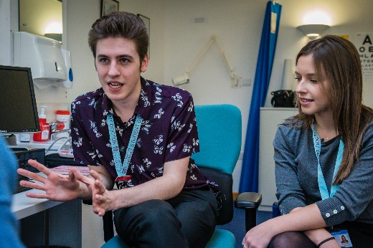
Lots of small group teaching
Graduated, integrated skills teaching supports patient-centred learning:
Clinical communication
Professionalism
General Practical
Practical procedures
Life support training
Supervised ward-based skills teaching
Skills in practice

Slide 22
Graduate outcomes
Very high scores in national examinations for Foundation application (SJT and Education Performance Measurement)
External examiners for Final MB comment consistently on students’ high levels of performance and achievement
> 90% gaining first choice Foundation School
Foundation exit questionnaires (end of F2) – Cambridge graduates ranked in top 5 nationally in their attainment of full specialty training posts (secondary care and GP)
GMC data – very high success rates in postgraduate exams
MBPhD: 80 alumni graduating between 1994 and 2008. 31 (39%) in full time academic careers (cf 10 -12% standard UK graduates) & 90% expressed plans for further full-time research.

Slide 23
Minimum subject requirements
Biology & Physics (or Dual Award Science) plus Maths, all at grade C or above at GCSE
A Level passes in Chemistry and two of Biology/Human Biology, Physics, Maths
In past three admissions rounds:
98% of applicants offered three or more science/maths A Levels, 30% offered a place
2% offered 2 science/maths A Levels, just 6% successful
Typical A Level offer: AA*A*
Typical IB offer: 40-41, with 776 at Higher Level
Check individual College websites

Slide 24
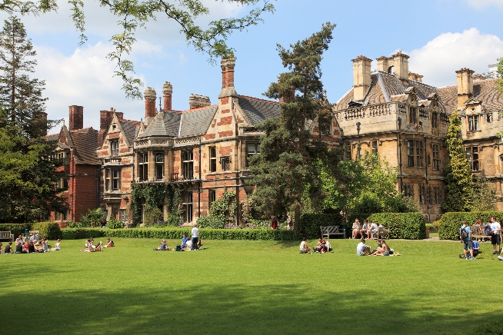
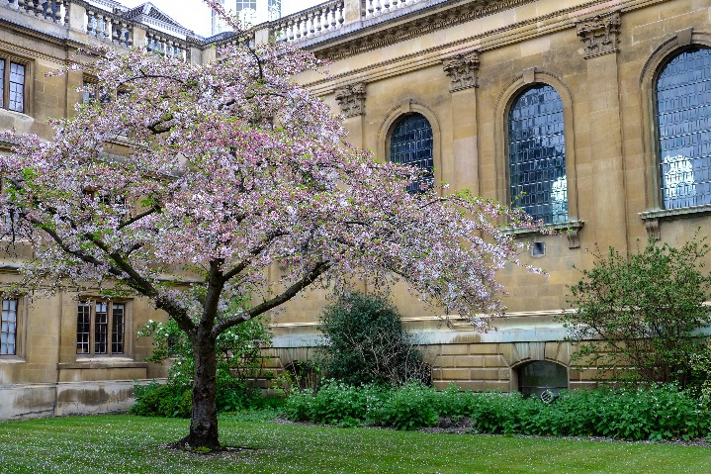
Choosing a College
Cambridge is a collegiate university
29 undergraduate colleges
3 Women’s colleges
Murray Edwards
Newnham
Lucy Cavendish (mature)
4 Mature colleges (21 and over)
Lucy Cavendish
St Edmunds
Wolfson
Hughes Hall (graduate course applicants only)
Pembroke College
Clare College

Slide 25
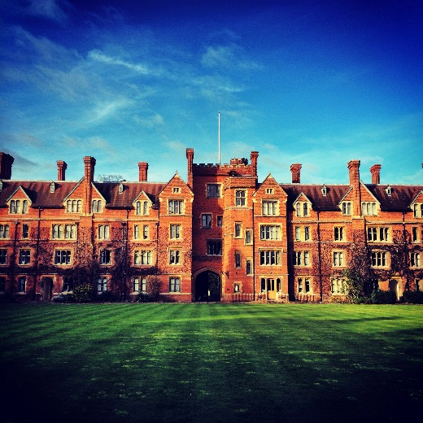
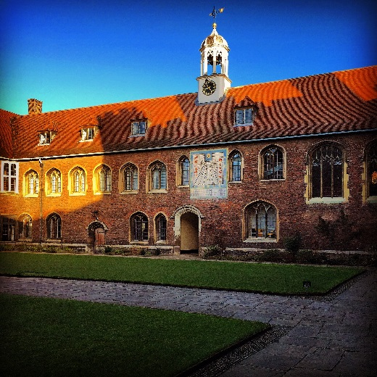
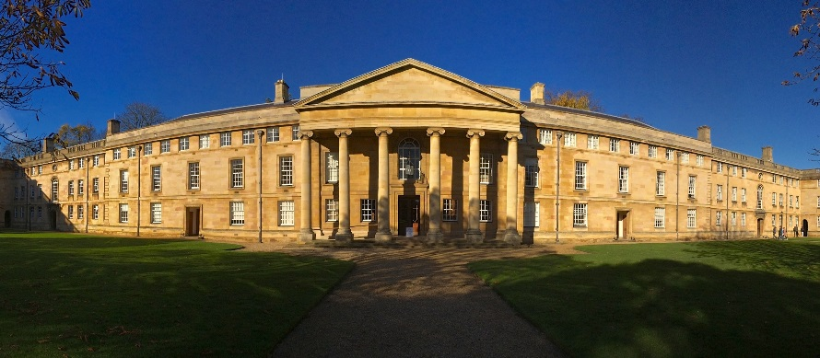
Cambridge Colleges
Choosing a College
Course
Age or gender
Size
Location
Appearance
Instinct
All provide:
Teaching, academic support, libraries and IT facilities
Personal support (eg tutor, nurse, porters)
Accommodation and dining facilities
Junior Common Room (JCR)
Sports, music and other recreational facilities
Selwyn College
Queens’ College
Downing College

Slide 26
Cambridge Undergraduate Admissions
Admissions are run by individual Colleges
All Colleges have similar admissions procedures (but not identical)
Application (via UCAS) to one College only
Open applications are acceptable (college allocated by computer algorithm)

Slide 27
Application Timeline
Early application date – 15 October 2019 (the same for all medical schools)
Ensure you are entered for the BMAT test
also used by Brighton, Imperial, Lancaster, Leeds, Oxford, Keele and UCL
UKCAT scores are not used by Cambridge

Slide 28
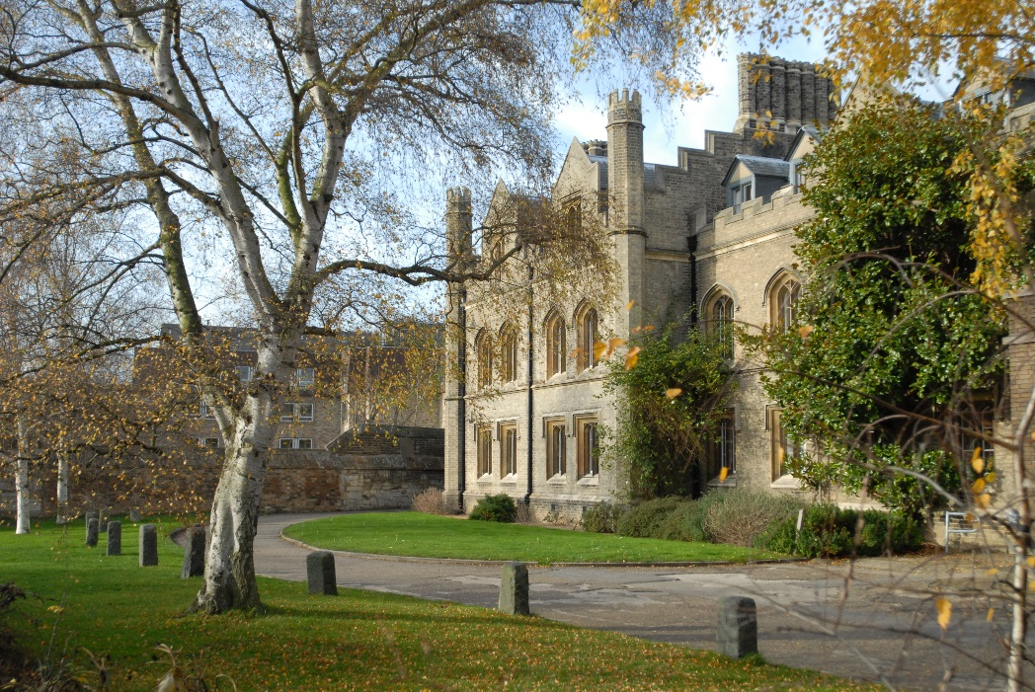
How we select
Many criteria
Academic record
School report
Personal statement
Admissions test (BMAT)
Interview

Slide 29
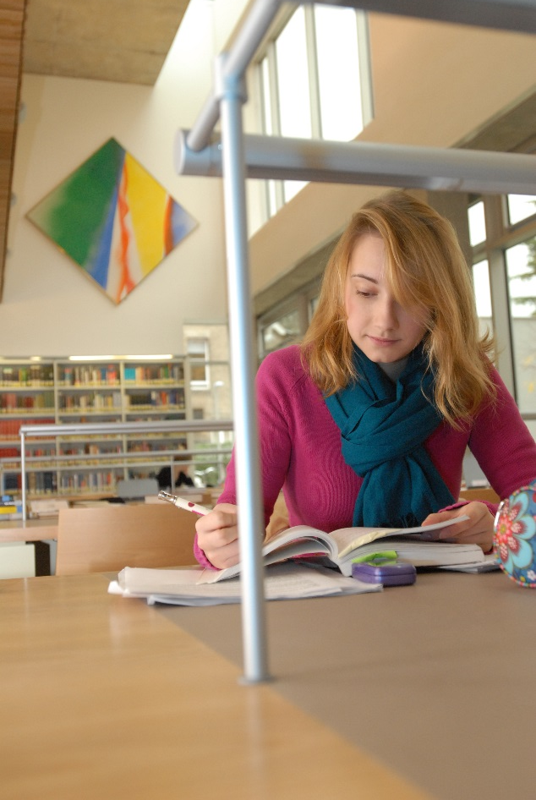
Academic record
GCSE grades
We like to see some A*s
B in a science, or C in anything else will be explored at interview

Slide 30
School report
Three A grade predictions (including at least two A*), unless special circumstances
Bland reports are not helpful
Gives us a basis for understanding you and your distinctive qualities

Slide 31
Personal statement
What motivates you? (avoid gush, banality)
What have you done to explore and develop your interests?
Especially your medicine-related experiences
What are your other interests and achievements?
What do you enjoy reading?
Don’t bluff!

Slide 32
BMAT
Two-hour paper
Two sittings:
September (approved centre)
November (school)
Three sections
60 minutes, mostly multiple choice
30 minutes, mostly multiple choice
30 minutes, sustained writing
www.bmat.org.uk

Slide 33
Interviews
Important part of the decision making process
Identify academic potential
First half of December
Prepare yourself
The College will usually tell you how many interviews and with whom:
typically at least two 20-minute interviews, one-to-one or with a pair of interviewers
Cambridge Graduate Course Medicine - multiple mini interviews

Slide 34
Interviews
Looking for people who can think on their feet
Interviews test your approach to:
Problem solving
Ability to think logically
Challenging ideas and questions
We also want to find out:
If you have a passion for science
If you can pursue an argument
If you are realistic about medicine
If any of your application needs explaining

Slide 35
Interview Preparation
Be prepared
Take advice, but be yourself
Do not exaggerate your interests

Slide 36
Questions?
www.undergraduate.study.cam.ac.uk/courses/medicine
www.biology.cam.ac.uk
www.medschl.cam.ac.uk
Current students, staff and course organisers on the stand outside this talk

